Slide 1


Data Mining and Data Warehousing
CSE-4107
Md. Manowarul Islam
Assistant Professor, Dept. of CSE
Jagannath University

Slide 2








The Apriori Algorithm — Example
Database D
L₁
C₁
Scan D
C₂
C₂
L₂
Scan D
C₃
Scan D
L₃

Slide 3
Candidate Generation
Basic principle (Apriori):
  An itemset of size k+1 is candidate to be frequent only if all of its subsets of size k are known to be frequent

Slide 4
Candidate Generation
Main idea:
  Construct a candidate of size k+1 by combining frequent itemsets of size k
    If k = 1, take the all pairs of frequent items
    If k > 1, join pairs of itemsets that differ by just one item
    For each generated candidate itemset ensure that all subsets of size k are frequent.

Slide 5
Generate Candidates C_{k+1}
Assumption: The items in an itemset are ordered
  E.g., if integers ordered in increasing order, if strings ordered in lexicographic order
    The order ensures that if item y > x appears before x, then x is not in the itemset
The items in L_{k} are also listed in an order
Create a candidate itemset of size k+1, by joining two itemsets of size k, that share the first k-1 items
Item 1 | Item 2 | Item 3
1 | 2 | 3
1 | 2 | 5

Slide 6
Generate Candidates C_{k+1}
Assumption: The items in an itemset are ordered
  E.g., if integers ordered in increasing order, if strings ordered in lexicographic order
    The order ensures that if item y > x appears before x, then x is not in the itemset
The items in L_{k} are also listed in an order
Create a candidate itemset of size k+1, by joining two itemsets of size k, that share the first k-1 items
Item 1 | Item 2 | Item 3
1 | 2 | 3
1 | 2 | 5
1 | 2 | 3 | 5

Slide 7
Generating Candidates C_{k+1} in SQL
self-join L_{k} ‏
  insert into C_{k+1}
  select p.item₁, p.item₂, …, p.item_{k}, q.item_{k}
  from L_{k} p, L_{k} q
  where p.item₁=q.item₁, …, p.item_{k-1}=q.item_{k-1}, p.item_{k} < q.item_{k}

Slide 8
  p.item₁=q.item₁,p.item₂=q.item₂, p.item₃< q.item₃
Example I
L₃={abc, abd, acd, ace, bcd}
Self-join: L₃*L₃
  abcd from abc and abd
  acde from acd and ace
item1 | item2 | item3
a | b | c
a | b | d
a | c | d
a | c | e
b | c | d
item1 | item2 | item3
a | b | c
a | b | d
a | c | d
a | c | e
b | c | d

Slide 9
  p.item₁=q.item₁,p.item₂=q.item₂, p.item₃< q.item₃
Example I
L₃={abc, abd, acd, ace, bcd}
Self-joining: L₃*L₃
  abcd from abc and abd
  acde from acd and ace
item1 | item2 | item3
a | b | c
a | b | d
a | c | d
a | c | e
b | c | d
item1 | item2 | item3
a | b | c
a | b | d
a | c | d
a | c | e
b | c | d

Slide 10
  p.item₁=q.item₁,p.item₂=q.item₂, p.item₃< q.item₃
Example I
L₃={abc, abd, acd, ace, bcd}
Self-joining: L₃*L₃
  abcd from abc and abd
  acde from acd and ace
item1 | item2 | item3
a | b | c
a | b | d
a | c | d
a | c | e
b | c | d
item1 | item2 | item3
a | b | c
a | b | d
a | c | d
a | c | e
b | c | d
{a,b,c}
{a,b,d}
{a,b,c,d}

Slide 11
  p.item₁=q.item₁,p.item₂=q.item₂, p.item₃< q.item₃
Example I
L₃={abc, abd, acd, ace, bcd}
Self-joining: L₃*L₃
  abcd from abc and abd
  acde from acd and ace
item1 | item2 | item3
a | b | c
a | b | d
a | c | d
a | c | e
b | c | d
item1 | item2 | item3
a | b | c
a | b | d
a | c | d
a | c | e
b | c | d
{a,c,d}
{a,c,e}
{a,c,d,e}

Slide 12
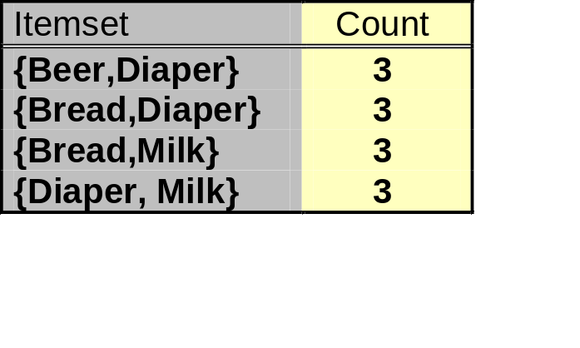
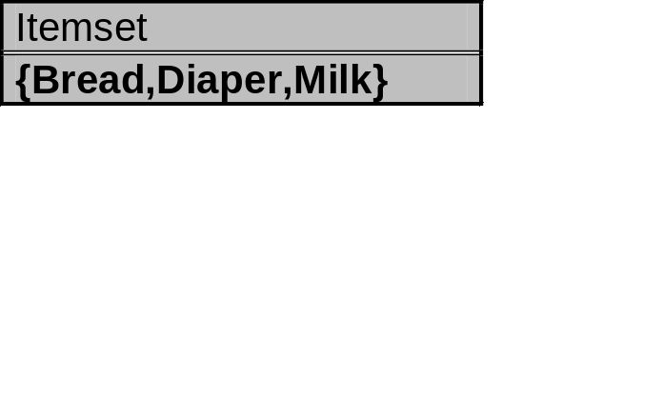
Example II
{Bread,Diaper}
√
{Bread,Milk}
√
{Diaper, Milk}
√

Slide 13
Example I
{a,b,c}
{a,b,d}
L₃={abc, abd, acd, ace, bcd}
Self-joining: L₃*L₃
  abcd from abc and abd
  acde from acd and ace
Pruning:
  abcd is kept since all subset itemsets are in L₃
  acde is removed because ade is not in L₃
C₄={abcd}
{a,b,c,d}
abc
abd
acd
bcd
√
√
√
√
{a,c,d}
{a,c,e}
{a,c,d,e}
acd
ace
ade
cde
√
√
X

Slide 14
Generate Candidates C_{k+1}
Are we done? Are all the candidates valid?
Pruning step:
  For each candidate (k+1)-itemset create all subset k-itemsets
  Remove a candidate if it contains a subset k-itemset that is not frequent
Item 1 | Item 2 | Item 3
1 | 2 | 3
1 | 2 | 5
1 | 4 | 5
1 | 2 | 3 | 5
Is this a valid candidate?
No. Subsets (1,3,5) and (2,3,5) should also be frequent
Apriori principle

Slide 15
Generate Candidates C_{k+1}
We have all frequent k-itemsets L_{k}
Step 1: self-join L_{k}‏
  Create set C_{k+1} by joining frequent k-itemsets that share the first k-1 items
Step 2: prune
  Remove from C_{k+1} the itemsets that contain a subset k-itemset that is not frequent

Slide 16

Frequent Itemset Generation
Lattice
Given d items, there are M = 2^{d} possible candidate itemsets

Slide 17
Frequent Itemset Generation
Brute-force approach:
  Each itemset in the lattice is a candidate frequent itemset
  Count the support of each candidate by scanning the database
  Match each transaction against every candidate
  Expensive since M = 2^{d} !!!
Transactions
List of
TID
Items
Candidates
1
Bread, Milk
2
Bread, Diaper, Beer, Eggs
N
3
Milk, Diaper, Beer, Coke
4
Bread, Milk, Diaper, Beer
M
5
Bread, Milk, Diaper, Coke
w

Slide 18
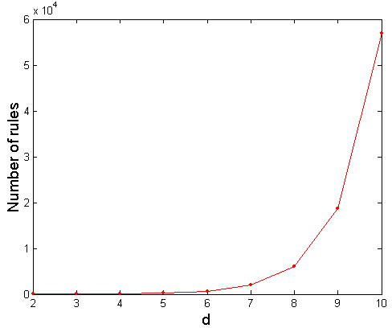
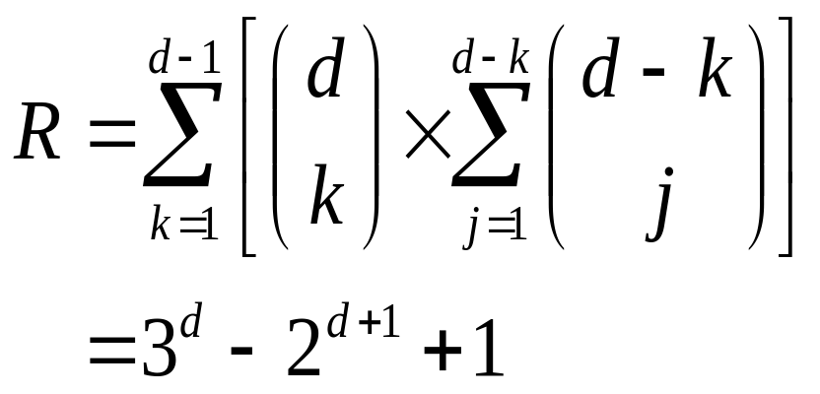
Computational Complexity
Given d unique items:
  Total number of itemsets = 2^{d}
  Total number of possible association rules:
If d=6, R = 602 rules
If d=20, R = 34,85,735,825 rules

Slide 19
Generate Candidates C_{k+1}
We have all frequent k-itemsets L_{k}
Step 1: self-join L_{k}‏
  Create set C_{k+1} by joining frequent k-itemsets that share the first k-1 items
Step 2: prune
  Remove from C_{k+1} the itemsets that contain a subset k-itemset that is not frequent

Slide 20
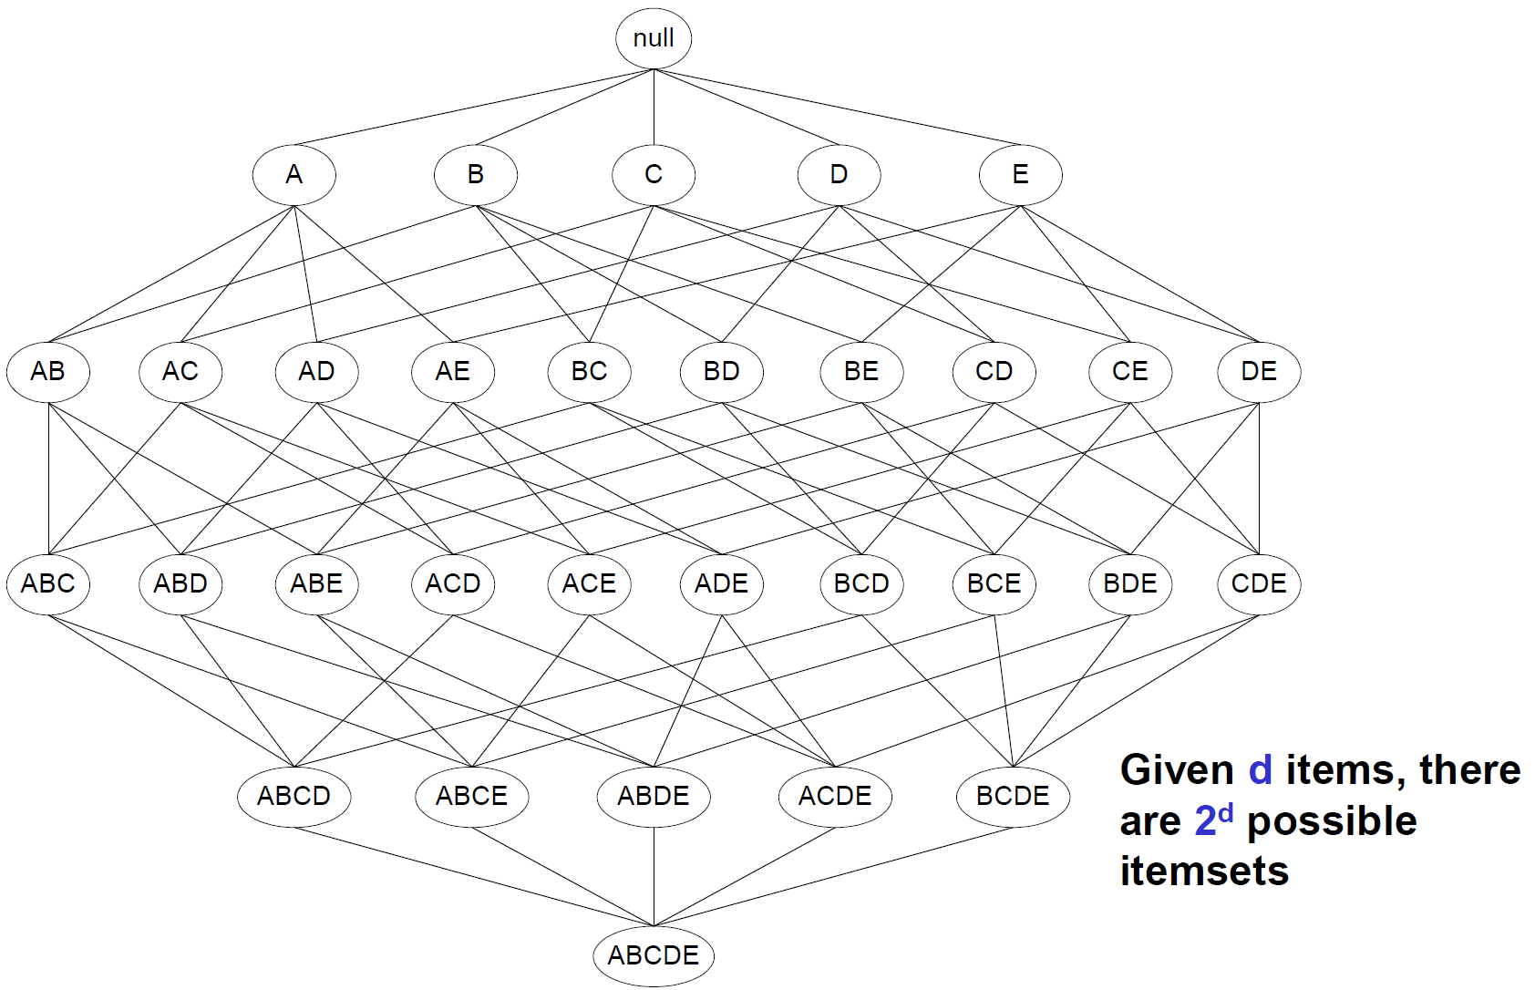
Illustration For Pruning Infrequent Itemsets
Suppose {AB}, {E}
are infrequent.
Pruned items

Slide 21
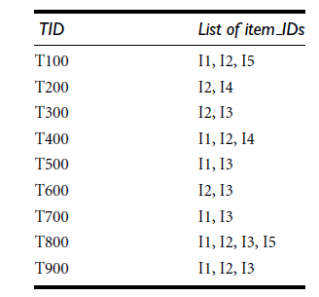
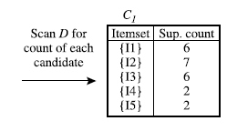
Apriori
Step 1: scans all of the transactions in order to count the number of occurrences of each item- C1

Slide 22
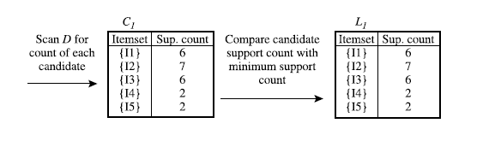
Apriori
Step 2: Determine the set of frequent 1-itemsets L1

Slide 23
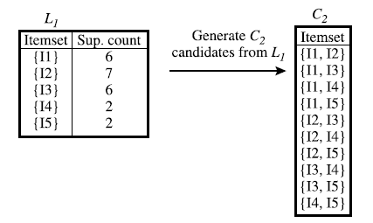
Apriori
Step 3: Generate C2- candidate 2-itemsets

Slide 24
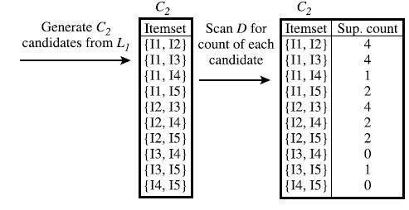
Apriori
Step 4: Generate C2- candidate 2-itemsets and scan the database

Slide 25
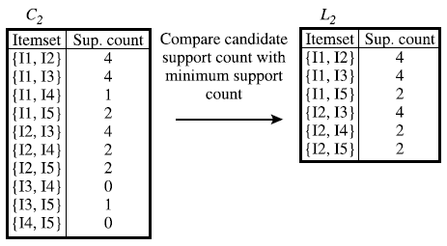
Apriori
Step 4: Determine the set of frequent 2-itemsets L2

Slide 26
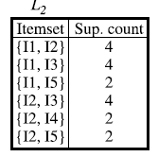
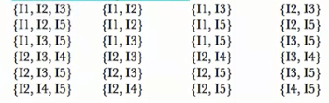
Apriori
Step 5: Generate C3- candidate 3-itemsets (pruning)

Slide 27
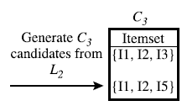
Apriori
Step 5: Generate C3- candidate 3-itemsets (pruning)

Slide 28
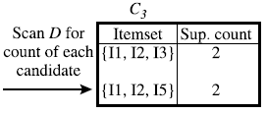
Apriori
Step 5: Generate C3- candidate 3-itemsets

Slide 29
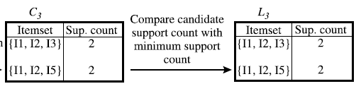
Apriori
Step 6: Determine the set of frequent 2-itemsets L2

Slide 30
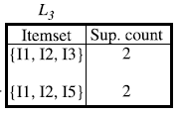
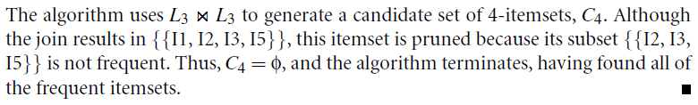
Apriori
Step 7: Determine the set of frequent 2-itemsets L2

Slide 31


Generate Association Rule
Once the frequent itemsets from database have been found, it is straightforward to generate strong association rules from them
strong association rules-association rules satisfy both minimum support and minimum confidence

Slide 32
Generate Association Rule
Suppose the data contain the frequent itemset l={I1,I2,I5}
The nonempty subsets of l are:
  {I1, I2},
  {I1, I5},
  {I2, I5},
  {I1},
  {I2},
  {I5}

Slide 33
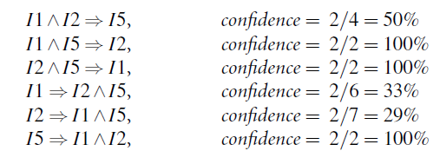
Generate Association Rule
Suppose the data contain the frequent itemset l={I1,I2,I5}
The resulting association rules are as shown below, each listed with its confidence:

Slide 34
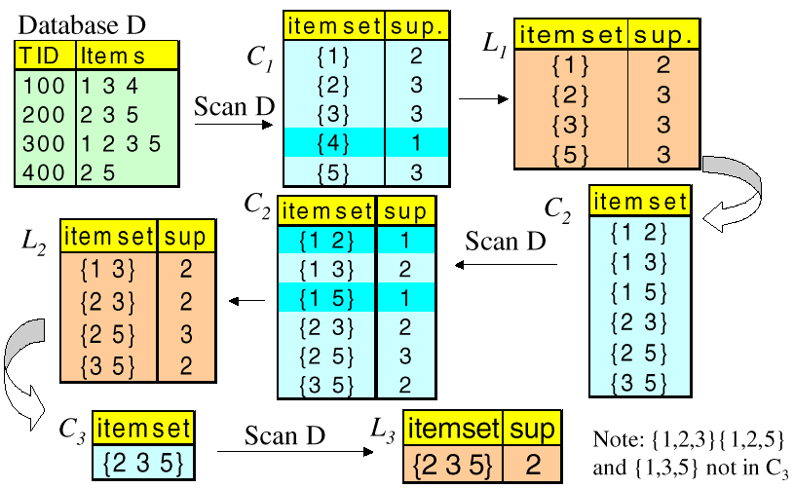
Apriori Algorithm - An Example
Assume minimum support = 2

Slide 35
Generating Association Rules
(Example Continued)
Item sets: {1,3} and {2,3,5}
Recall that confidence of a rule LHS → RHS is Support of itemset (i.e. LHS ∪ RHS) divided by support of LHS.
Candidate rules for {1,3} |  | Candidate rules for {2,3,5}
Rule | Conf. | Rule | Conf. | Rule | Conf.
{1}→{3} | 2/2 = 1.0 | {2,3}→{5} | 2/2 = 1.00 | {2}→{5} | 3/3 = 1.00
{3}→{1} | 2/3 = 0.67 | {2,5}→{3} | 2/3 = 0.67 | {2}→{3} | 2/3 = 0.67
 |  | {3,5}→{2} | 2/2 = 1.00 | {3}→{2} | 2/3 = 0.67
 |  | {2}→{3,5} | 2/3 = 0.67 | {3}→{5} | 2/3 = 0.67
 |  | {3}→{2,5} | 2/3 = 0.67 | {5}→{2} | 3/3 = 1.00
 |  | {5}→{2,3} | 2/3 = 0.67 | {5}→{3} | 2/3 = 0.67
Assuming a min. confidence of 75%, the final set of rules reported by
Apriori are: {1}→{3}, {3,5}→{2}, {5}→{2} and {2}→{5}

Slide 36
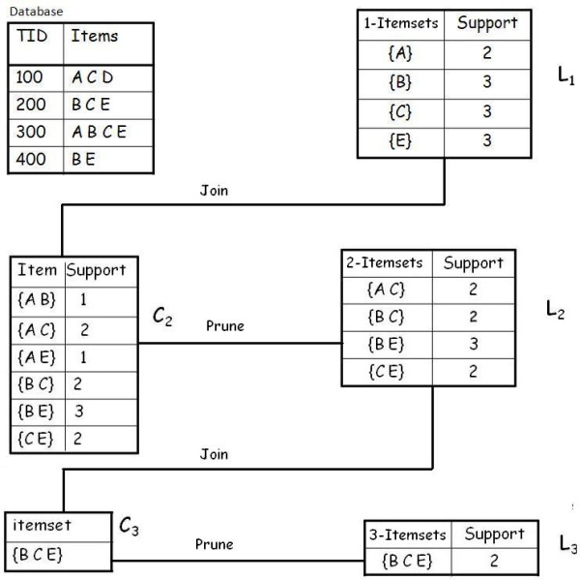
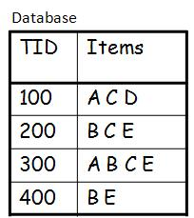
Example
A database has five transactions. Let the min sup = 50% and min con f = 80%.
Solution
Step 1: Find all Frequent Itemsets
Frequent Itemset:
{A} {B} {C} {E} {A C} {B C} {B E} {C E} {B C E}

Slide 37
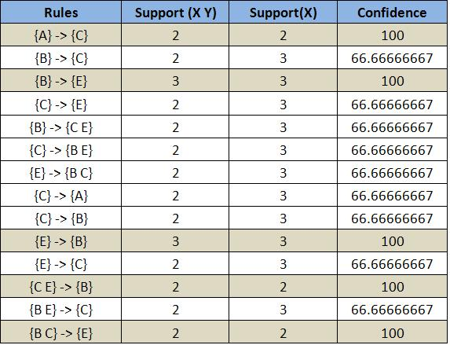
Step 2: Generate strong association rules from the frequent itemsets
Example
A database has five transactions. Let the min sup = 50% and min con f = 80%.

Slide 38
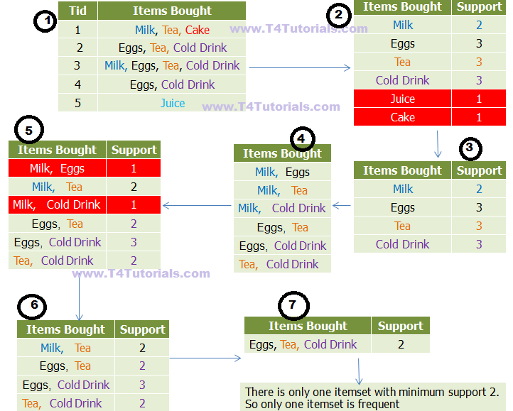


Slide 39
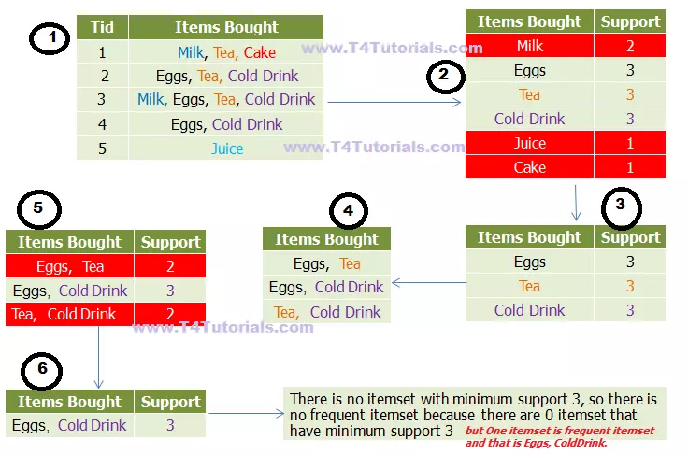

Slide 40
Break

Slide 41
FP Mining with Vertical Data Format
Both Apriori and FP-growth use horizontal data format
TID | List of item IDS
T100 | I1,I2,I5
T200 | I2,I4
T300 | I2,I3
T400 | I1,I2,I4
T500 | I1,I3
T600 | I2,I3
T700 | I1,I3
T800 | I1,I2,I3,I5
T900 | I1,I2,I3

Slide 42
FP Mining with Vertical Data Format
Alternatively data can also be represented in vertical format
itemset | TID_set
I1 | {T100,T400,T500,T700,T800,T900}
I2 | {T100,T200,T300,T400,T600,T800,T900}
I3 | {T300,T500,T600,T700,T800,T900}
I4 | {T200,T400}
I5 | {T100,T800}

Slide 43
FP Mining with Vertical Data Format
Transform the horizontally formatted data to the vertical format by scanning the database once
The support count of an itemset is simply the length of the TID_set of the itemset
TID | List of item IDS
T100 | I1,I2,I5
T200 | I2,I4
T300 | I2,I3
T400 | I1,I2,I4
T500 | I1,I3
T600 | I2,I3
T700 | I1,I3
T800 | I1,I2,I3,I5
T900 | I1,I2,I3
itemset | TID_set
I1 | {T100,T400,T500,T700,T800,T900}
I2 | {T100,T200,T300,T400,T600,T800,T900}
I3 | {T300,T500,T600,T700,T800,T900}
I4 | {T200,T400}
I5 | {T100,T800}

Slide 44
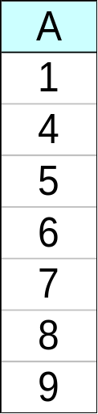
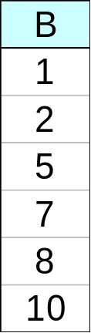
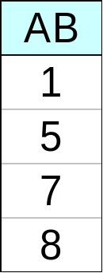
FP Mining with Vertical Data Format
Determine support of any k-itemset by intersecting tid-lists of two of its (k-1) subsets
∧
→

Slide 45
FP Mining with Vertical Data Format
The frequent k-itemsets can be used to construct the candidate (k+1)-itemsets based on the Apriori property
Frequent 2-itemsets in vertical format
Frequent 1-itemsets in vertical format
itemset | TID_set
{I1,I2} | {T100,T400,T800,T900}
{I1,I3} | {T500,T700,T800,T900}
{I1,I4} | {T400}
{I1,I5} | {T100,T800}
{I2,I3} | {T300,T600,T800,T900}
{I2,I4} | {T200,T400}
{I2,I5} | {T100,T800}
{I3,I5} | {T800}
itemset | TID_set
I1 | {T100,T400,T500,T700,T800,T900}
I2 | {T100,T200,T300,T400,T600,T800,T900}
I3 | {T300,T500,T600,T700,T800,T900}
I4 | {T200,T400}
I5 | {T100,T800}
min_sup=2

Slide 46
FP Mining with Vertical Data Format
The frequent k-itemsets can be used to construct the candidate (k+1)-itemsets based on the Apriori property
Frequent 2-itemsets in vertical format
itemset | TID_set
{I1,I2} | {T100,T400,T800,T900}
{I1,I3} | {T500,T700,T800,T900}
{I1,I5} | {T100,T800}
{I2,I3} | {T300,T600,T800,T900}
{I2,I4} | {T200,T400}
{I2,I5} | {T100,T800}
Frequent 3-itemsets in vertical format
itemset | TID_set
{I1,I2,I3} | {T800,T900}
{I1,I2,I5} | {T100,T800}
min_sup=2

Slide 47
Mining Various Kinds of Association Rules
Mining multilevel association
Miming multidimensional association
Mining quantitative association
Mining interesting correlation patterns

Slide 48
Mining Various Kinds of Association Rules
Multilevel association rules involve concepts at different levels of abstraction.
Multidimensional association rules involve more than one dimension or predicate
  e.g., rules relating what a customer buys as well as the customer’s age.

Slide 49
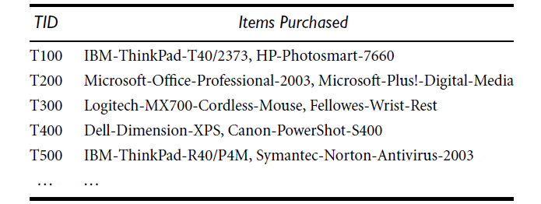
Mining Multiple-Level Association Rules
It is difficult to find interesting purchase patterns
An AllElectronics store, showing the items purchased for each transaction.

Slide 50
Mining Multiple-Level Association Rules
“IBM-ThinkPad-R40/P4M” or “Symantec-Norton-Antivirus-2003” occurs in a very small fraction of the transactions
  difficult to find strong associations

Slide 51
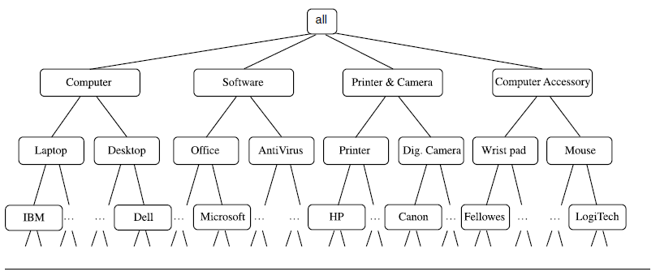
Mining Multiple-Level Association Rules
Data can be generalized by replacing low-level concepts within the data by their higher-level concepts.
strong associations between generalized abstractions of the items
  “IBM laptop computer” and “antivirus software.”

Slide 52
Mining Multiple-Level Association Rules
Items often form hierarchy.
Items at the lower level are expected to have lower support.
Rules regarding itemsets at
appropriate levels could be quite useful.
Food
Milk
Bread
Skim
2%
Wheat
White

Slide 53
Mining Multiple-Level Association Rules
Items often form hierarchies
Flexible support settings
  Items at the lower level are expected to have lower support
Exploration of shared multi-level mining

Slide 54
Mining Multiple-Level Association Rules
Using uniform minimum support for all levels
  uniform support – level 1: 5% and level 2: 5%
  Milk and fat milk is frequent
  Milk is frequnt but Skim milk is infrequent.
Level 1
min_sup = 5%
Milk
[support = 10%]
Level 2
min_sup = 5%
Fat Milk
[support = 6%]
Skim Milk
[support = 4%]

Slide 55
Mining Multiple-Level Association Rules
Using reduced minimum support at lower levels
  reduced support - level 1: 5% and level 2: 3%
  Milk and fat milk is frequent
  Milk and Skim milk is also frequent.
Level 1
min_sup = 5%
Milk
[support = 10%]
Level 2
min_sup = 3%
Fat Milk
[support = 6%]
Skim Milk
[support = 4%]

Slide 56
Mining Multiple-Level Association Rules
A top down, progressive deepening approach:
  First find high-level strong rules:
milk → bread [20%, 60%].
  Then find their lower-level “weaker” rules:
full fat milk → wheat bread [6%, 50%].
Food
Milk
Bread
Skim
FAT2%
Wheat
White

Slide 57
Multi-Dimensional Association: Concepts
Single-dimensional rules:
    buys(X, “milk”) ⇒ buys(X, “bread”)
Multi-dimensional rules: ≥2 dimensions or predicates
  Inter-dimension association rules (no repeated predicates)
    age(X,”19-25”) ∧ occupation(X,“student”) ⇒ buys(X,“coke”)
  hybrid-dimension association rules (repeated predicates)
    age(X,”19-25”) ∧ buys(X, “popcorn”) ⇒ buys(X, “coke”)

Slide 58
Thank you

